Slide 1


easier to use
Pier 15:
Breaking Good
Pier 15: Breaking Good
Combating the growing problem of counterfeit drugs

Slide 2

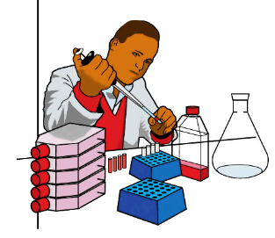


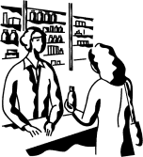
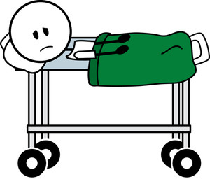
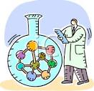
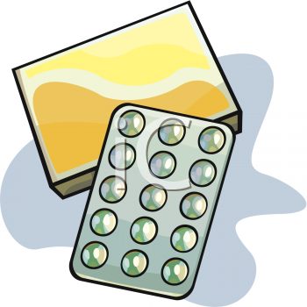
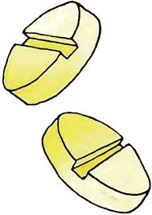
A complex problem
1.
2.
3.

Slide 3

Solution 1
An instrument to detect counterfeiting by
chemical analysis

Slide 4
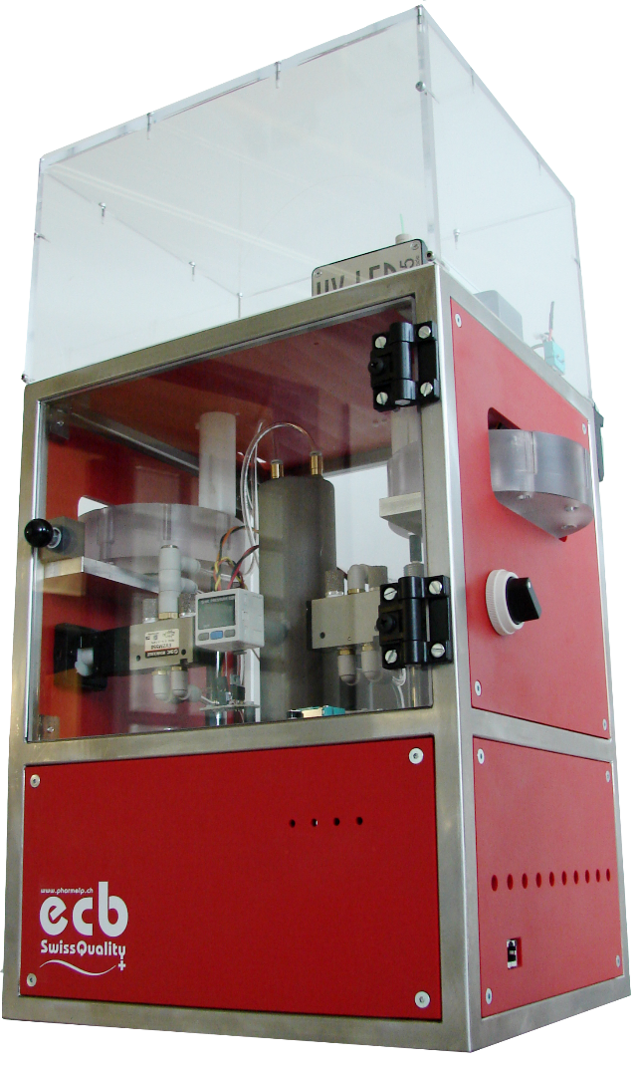
ECB: Our upgrades
Replacement of injection pump with manual feed
Lower cost / size / weight
Automated analysis
Saves man hours
Increased reliability
Additional detection method
Conductivity based
Wizard tool
Lower operational costs
Capacity building

Slide 5
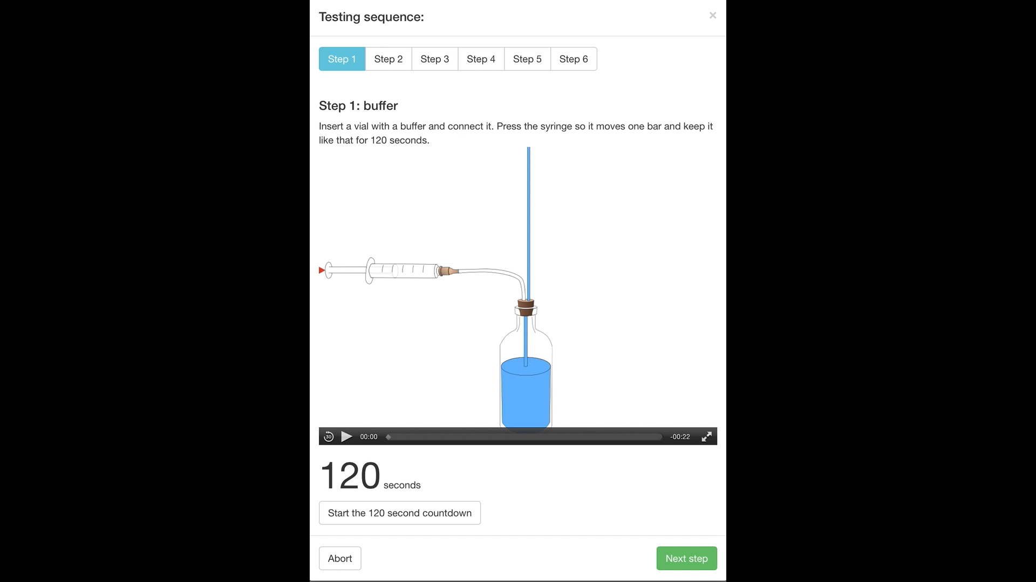
Web based training tool

Slide 6
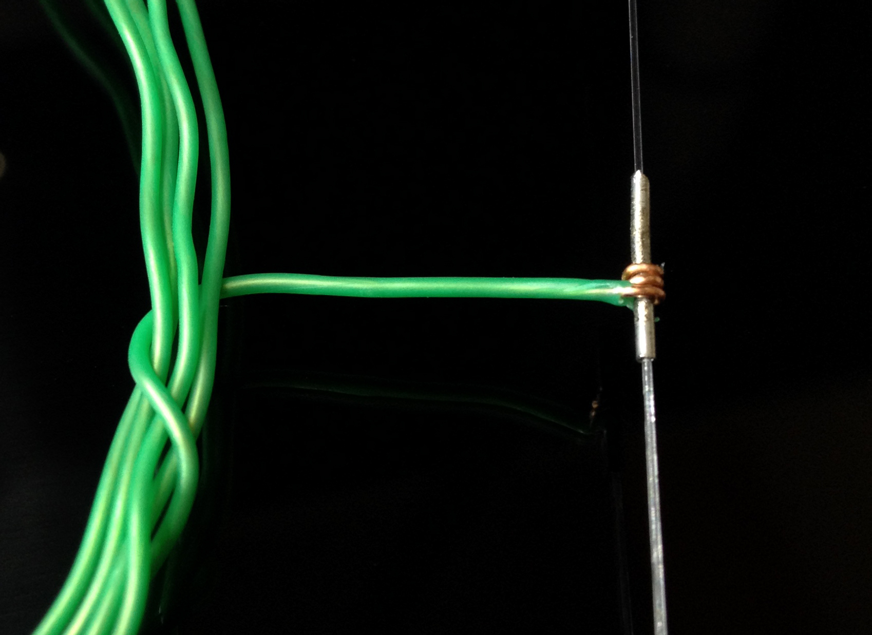
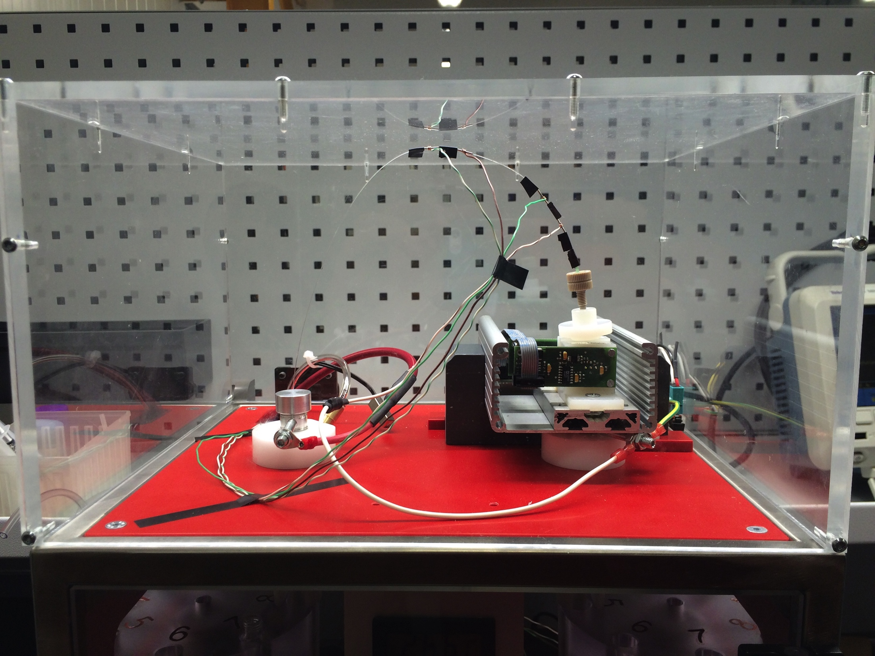

Slide 7
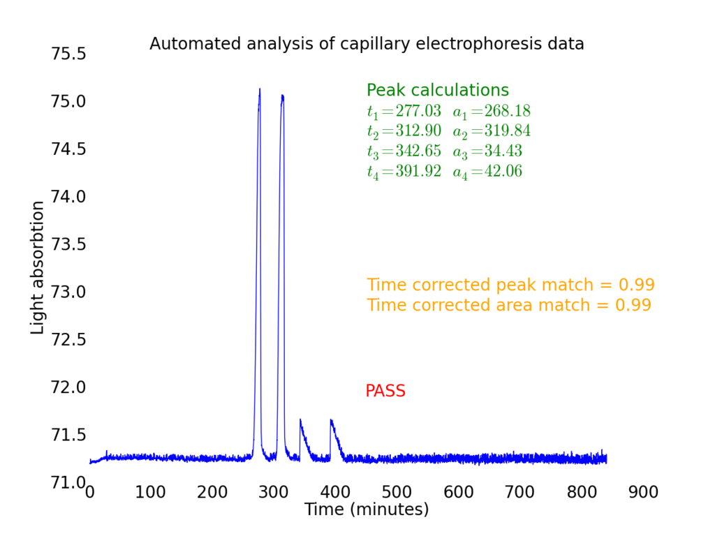
Automated analysis

Slide 8
Solution 2
Secure tracking of supply chain from manufacturer to consumer

Slide 9
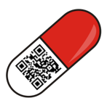






The system at a glance

Slide 10
Blockchain-based verification
Unbreakable
“Trustless”
Transparent
Powered by the “Authenticity” that fuels Bitcoins
Forces accountability at every point in the supply chain
Inherently incentivized crowdsourcing model

Slide 11
1 + 2 =
Solution 3
A tool to aggregate global data on incidences of counterfeiting

Slide 12
A more holistic approach to data
Target users
Consumers, national regulatory authorities, suppliers, and policymakers
Key components
Multiple-source global counterfeit drug surveillance network
Automated aggregation of pass/fail data from two verified sources - chemical analysis (Solution 1) and blockchain verification system (Solution 2)
Also collects data from end-users / patients, other databases
Info on medicine, location, and source of the incidence report
Flexible, customizable, independently verifiable – based on organizational / individual needs

Slide 13
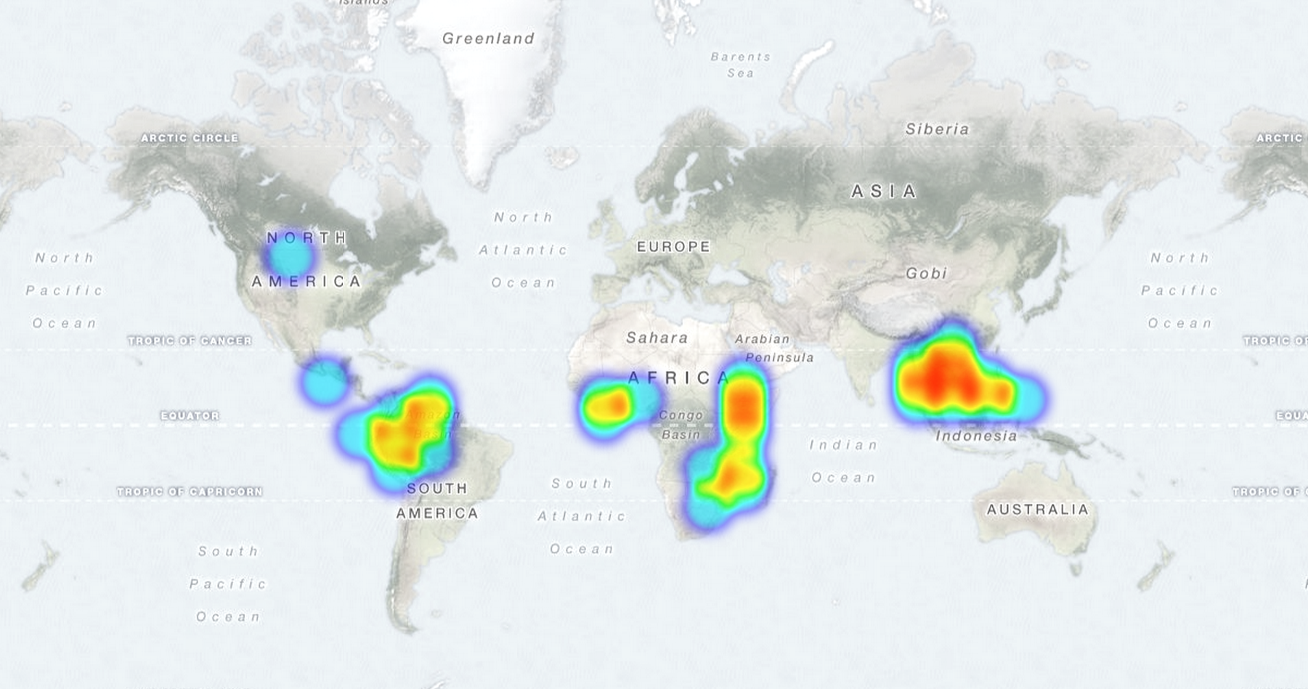
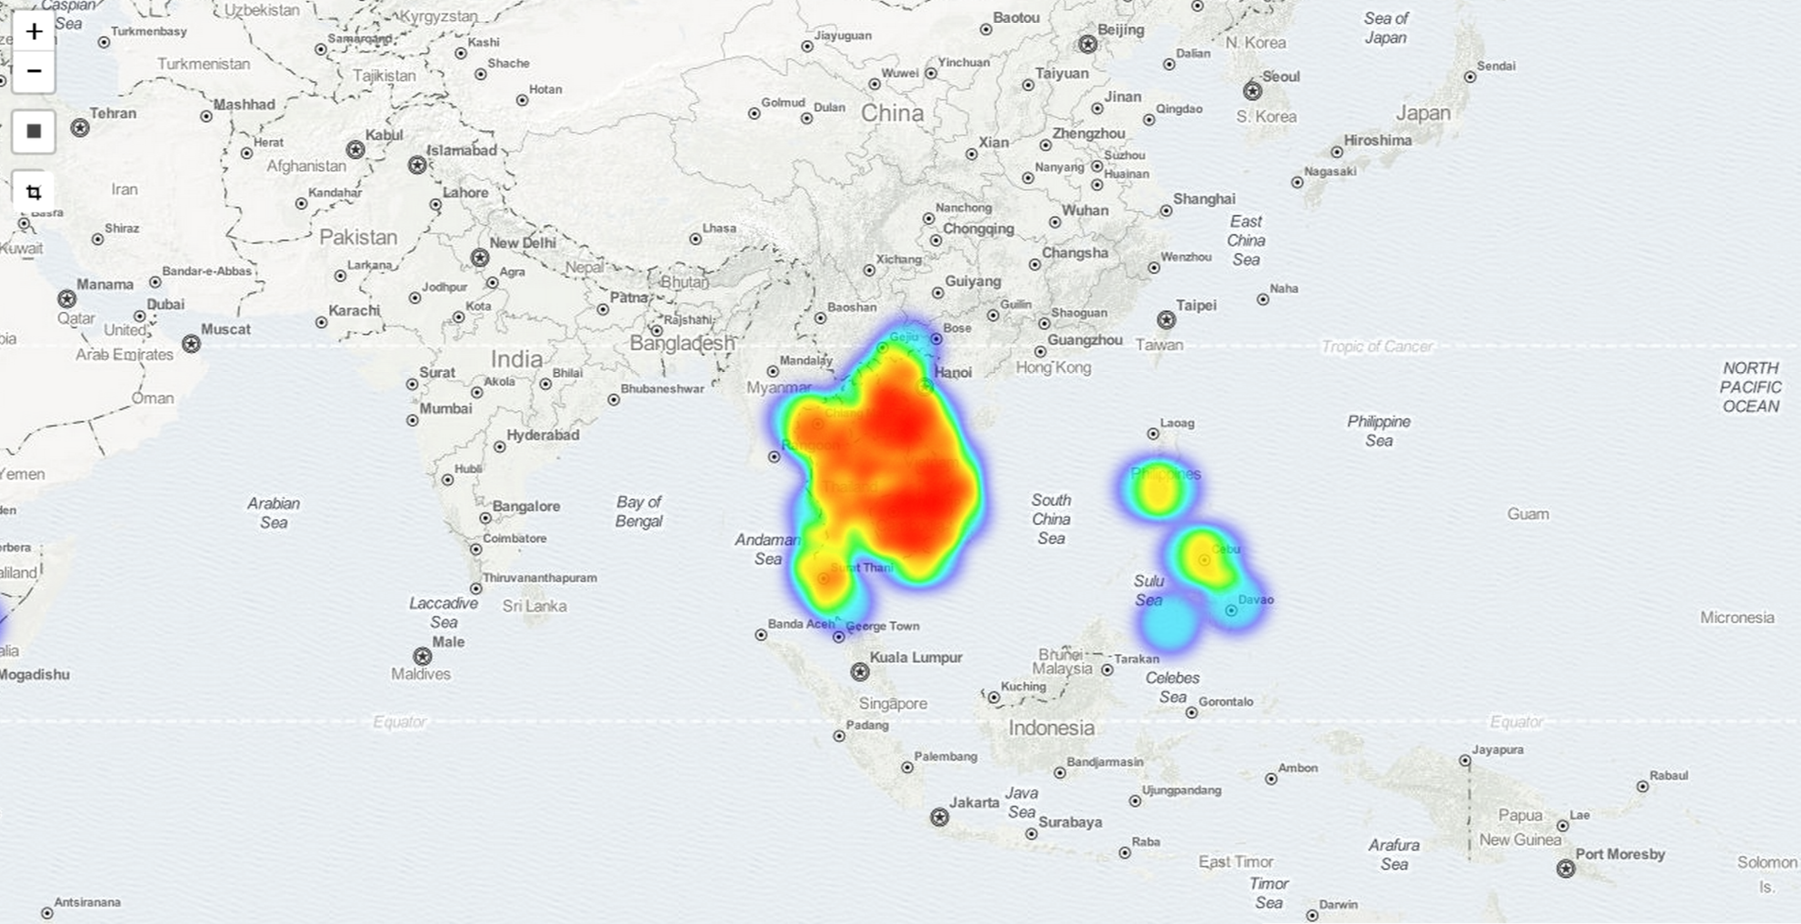
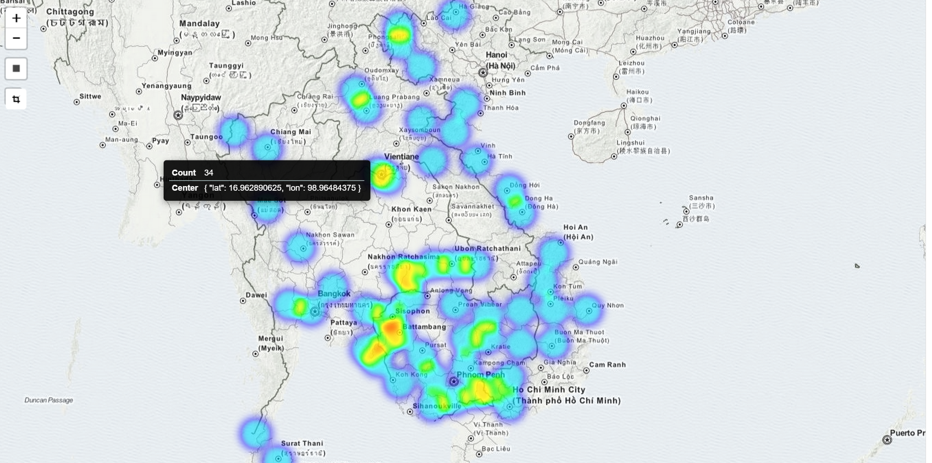
The power of reliable data

Slide 14
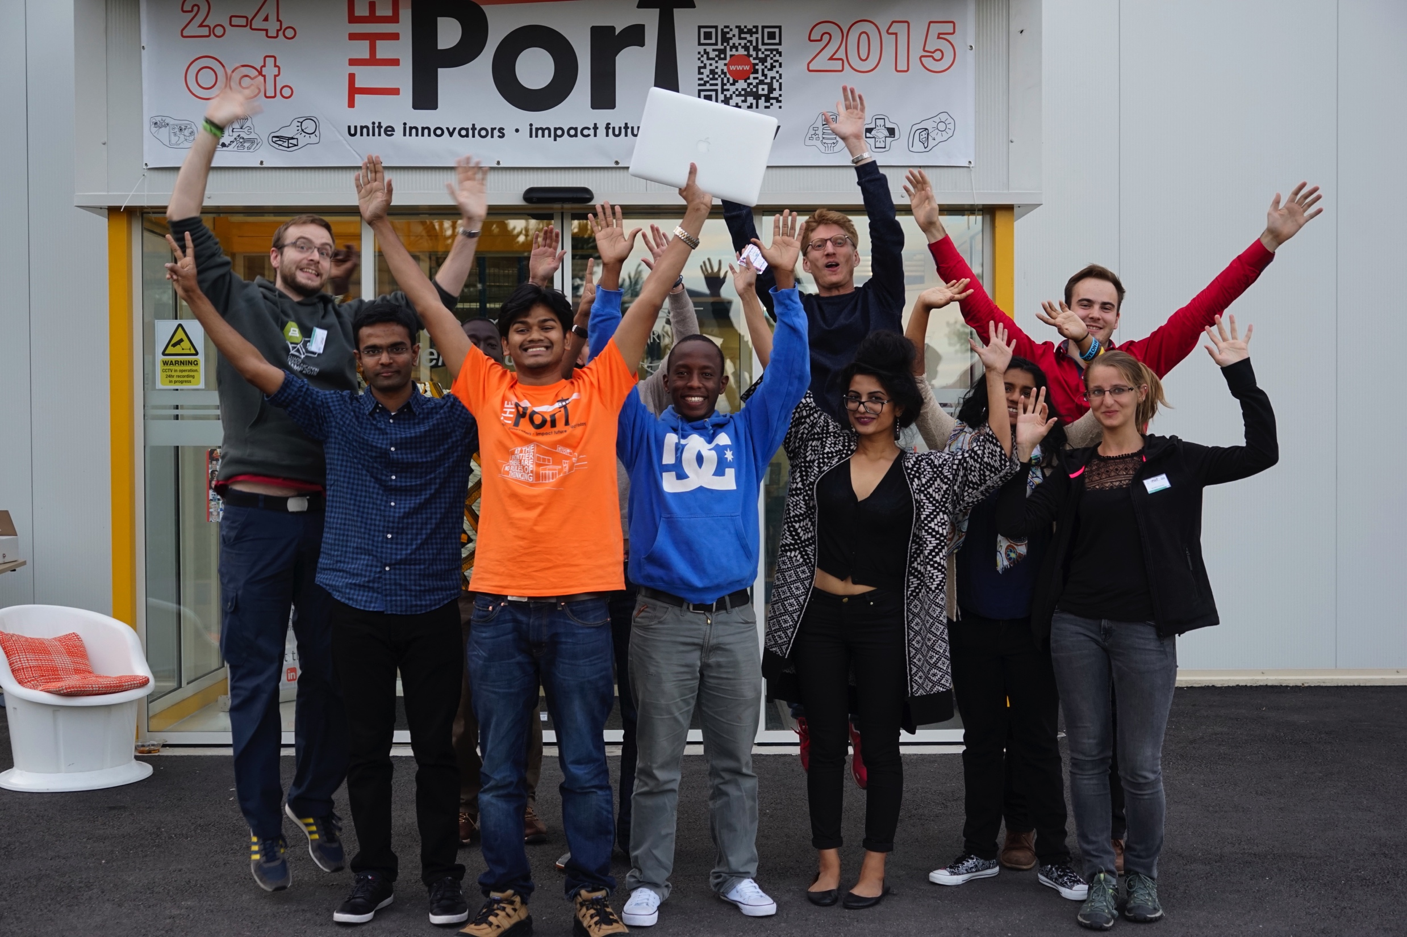
Thank you

